Slide 1
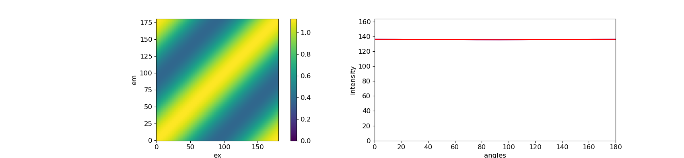
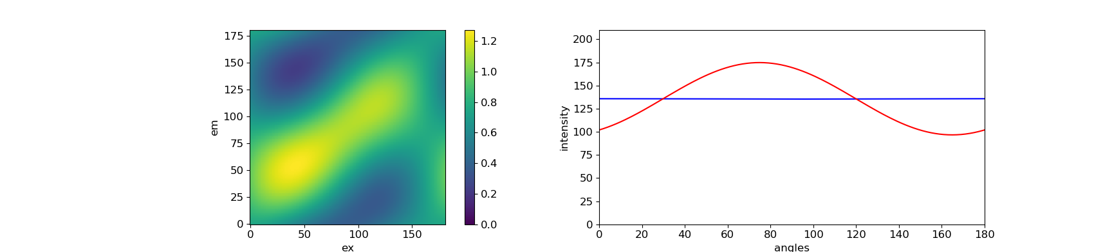
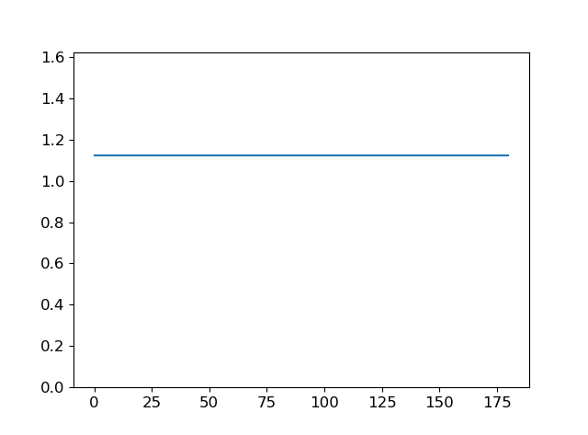
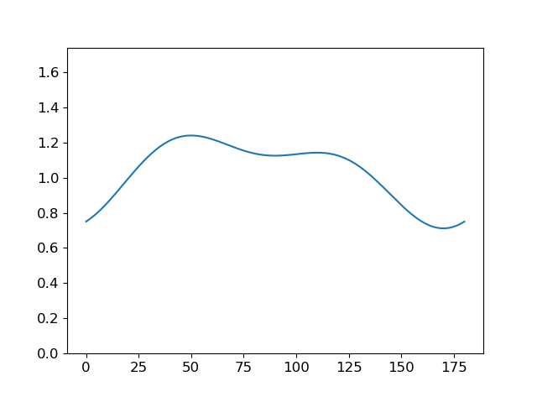
theta = [0, 60, 120]
et_matrix = ([1.0, 0.0, 0.0],
[0.0, 1.0, 0.0],
[0.0, 0.0, 1.0])
theta = [0, 60, 120]
et_matrix = ([0.5, 0.5, 0.0],
[0.0, 1.0, 0.0],
[0.0, 0.0, 1.0])

Slide 2
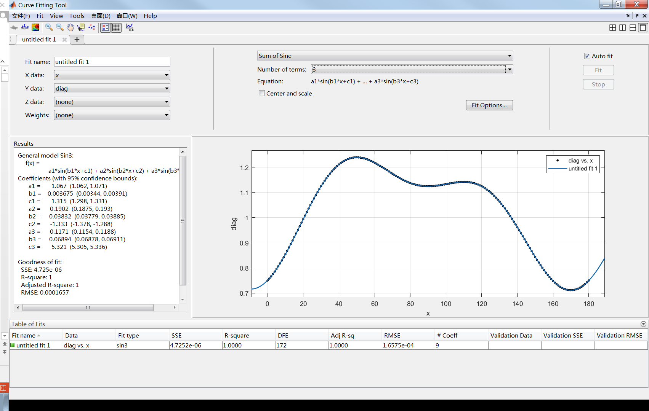

Slide 3
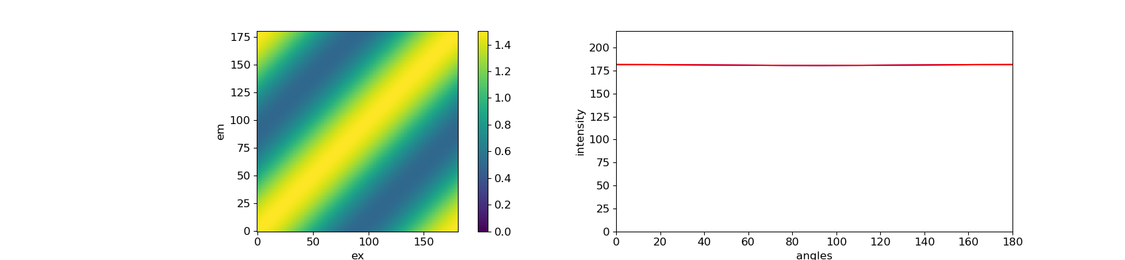
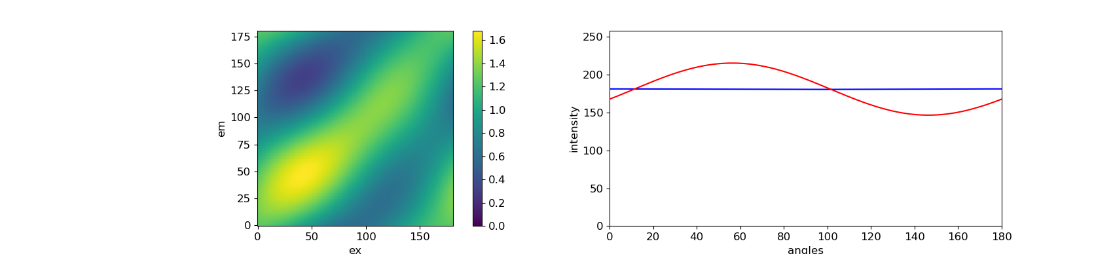
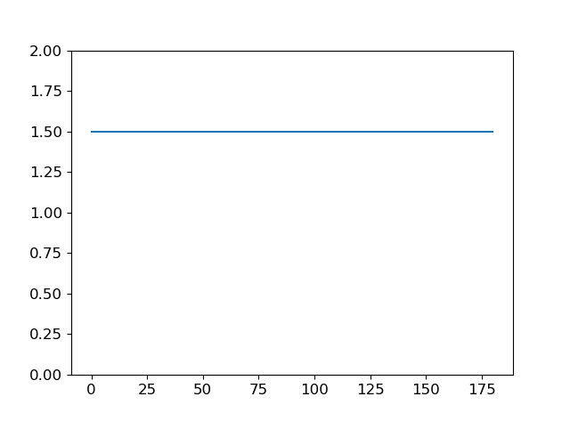
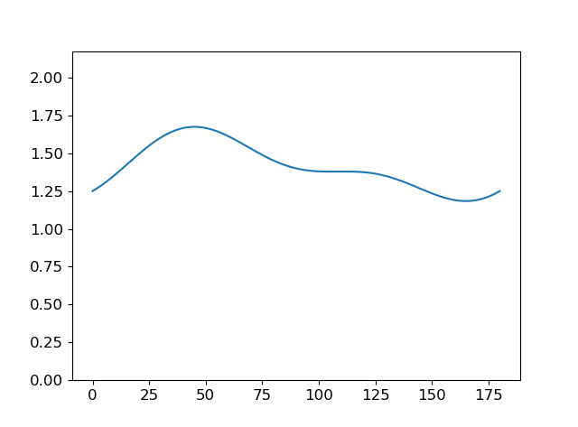
theta = [0, 45, 90, 135]
et_matrix = ([0.5, 0.5, 0.0, 0.0],
[0.0, 1.0, 0.0, 0.0],
[0.0, 0.2, 0.8, 0.0],
[0.0, 0.0, 0.0, 1.0])

Slide 4
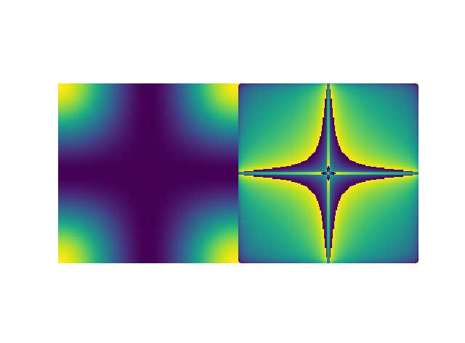
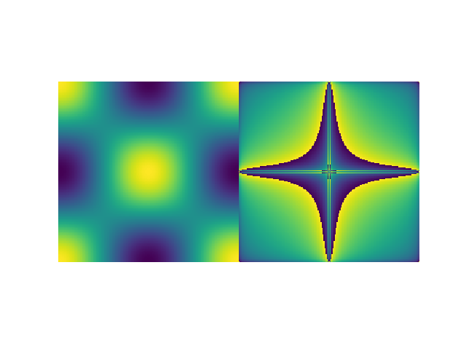
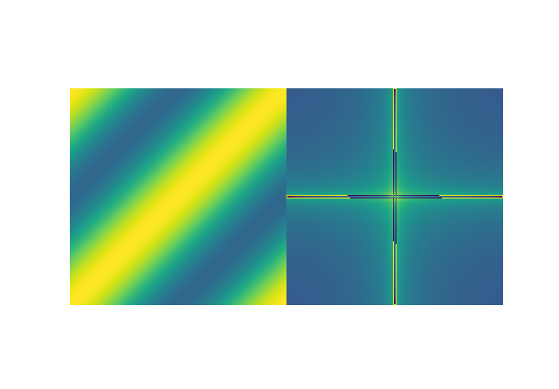
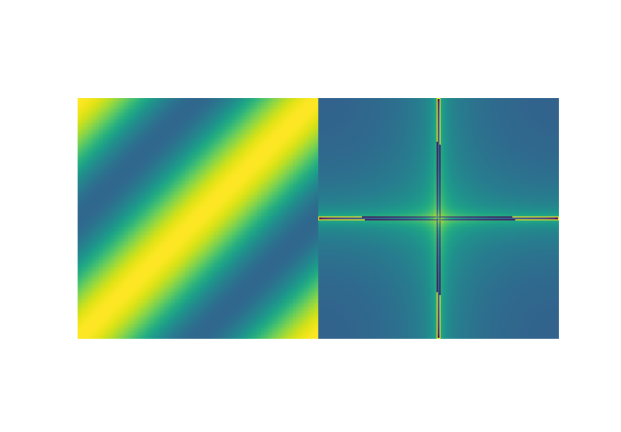


0
0, 90
0, 60, 120
0, 45, 90, 135
0, 36, 72, 108, 144
0, 30, 60, 90, 120, 150

Slide 6
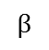
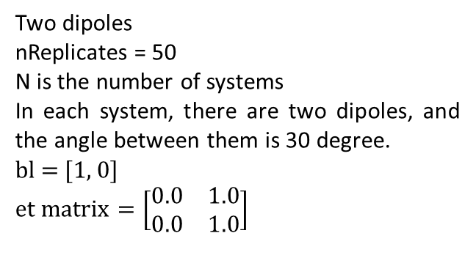
Two dipoles
nReplicates = 50
N is the number of systems
In each system, there are two dipoles, and the angle between them is 30 degree.
bl = [1, 0]
$$et matrix=\left[\begin{matrix}0.0 & 1.0 \\ 0.0 & 1.0\end{matrix}\right]$$
100%
$$β$$
A molecule have independent polarized absorber (M = 1) and emitter (M = 1). 100% energy transfer from absorber to emitter.
N = 1
N = 2
N = 4

Slide 7
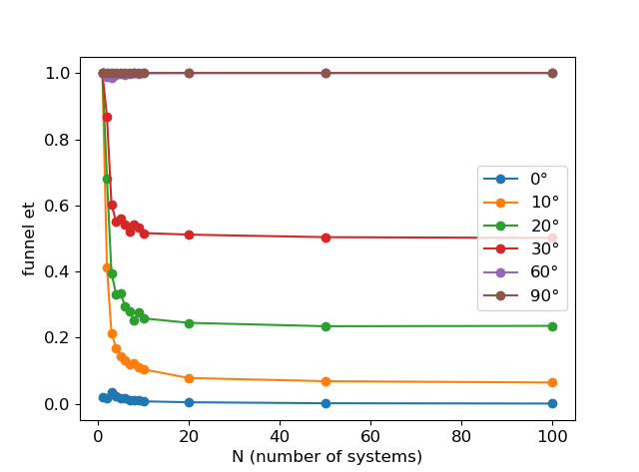
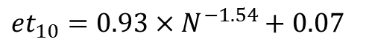
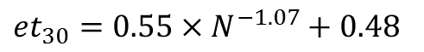
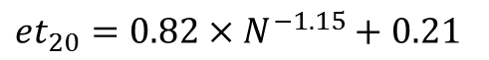
Plot N – et for different angle between two dipoles
Fitting of 40 degree is not good
${et}_{30}=0.55×N^{−1.07}+0.48$
${et}_{20}=0.82×N^{−1.15}+0.21$
${et}_{10}=0.93×N^{−1.54}+0.07$

Slide 8
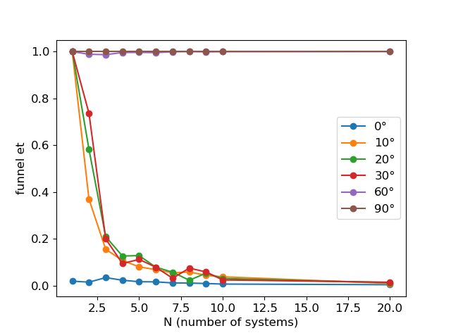

Slide 9
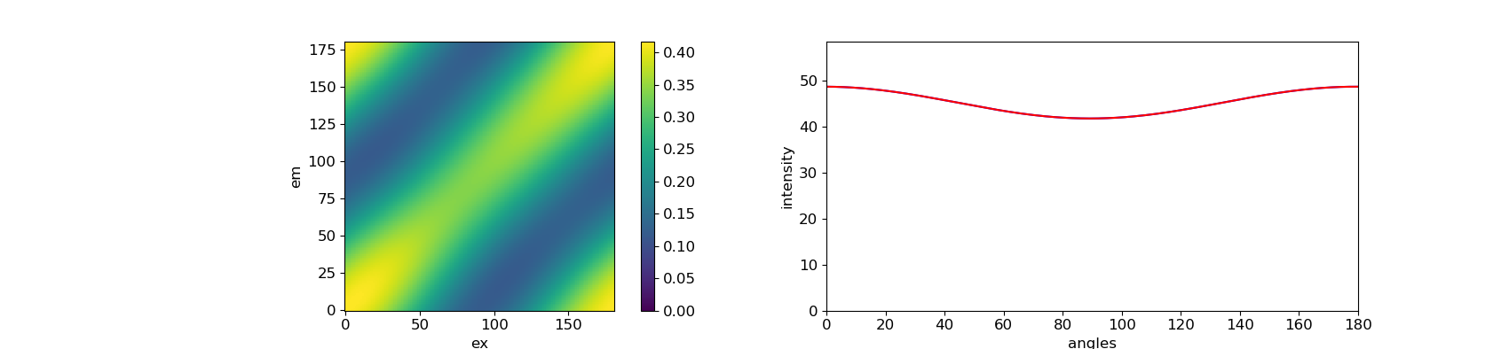
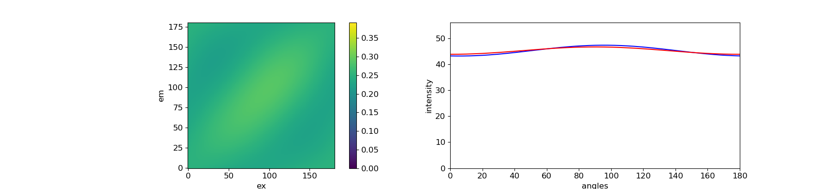
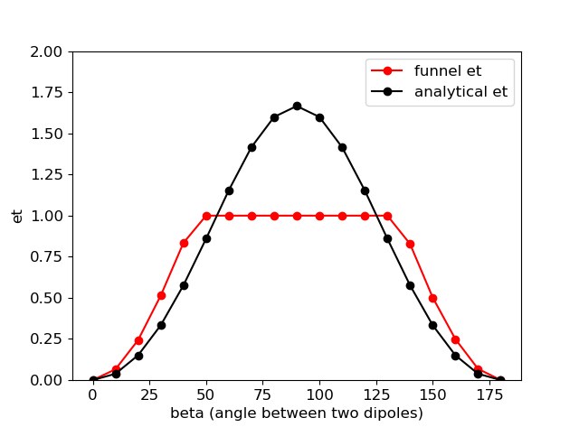
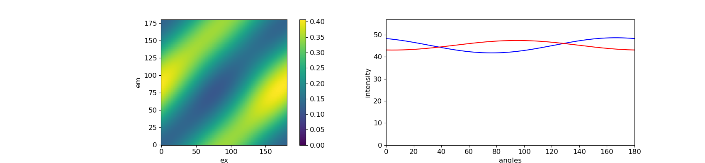
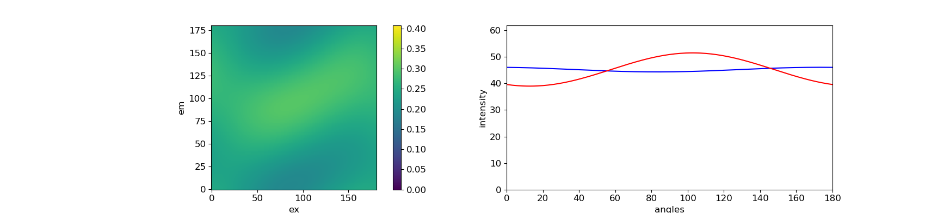
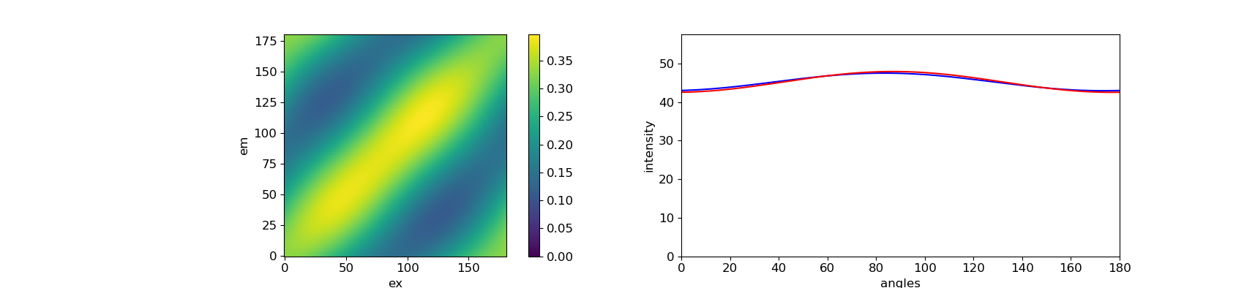
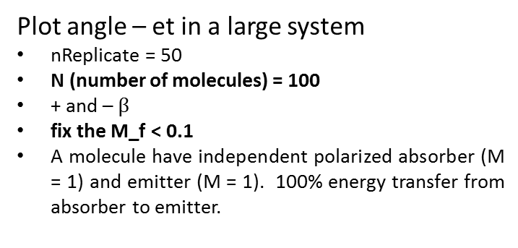
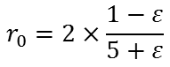
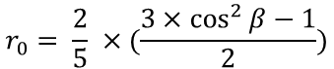
Funnel et
Plot angle – et in a large system
nReplicate = 50
N (number of molecules) = 100
+ and – $β$
fix the M_f < 0.1
A molecule have independent polarized absorber (M = 1) and emitter (M = 1). 100% energy transfer from absorber to emitter.
100%
0°
β | et | residue
0° | 0 | 0.004
10° | 0.065 | 0.005
20° | 0.243 | 0.007
30° | 0.514 | 0.007
40° | 0.834 | 0.006
50° | 1 | 0.016
60° | 1 | 0.037
70° | 1 | 0.056
80° | 1 | 0.069
90° | 1 | 0.074
100° | 1 | 0.069
110° | 1 | 0.056
120° | 1 | 0.036
130° | 1 | 0.014
140° | 0.828 | 0.005
150° | 0.502 | 0.006
160° | 0.249 | 0.007
170° | 0.068 | 0.007
180° | 0 | 0.004
$$β$$
40°
80°
140°
analytical et
$$r_{0}= \frac{2}{5} ×(\frac{3×\cos^{2}{β}−1}{2})$$
$$r_{0}=2×\frac{1−ε}{5+ε}$$
Can we use this eq. here? The situation is sligtly different
170°

Slide 10
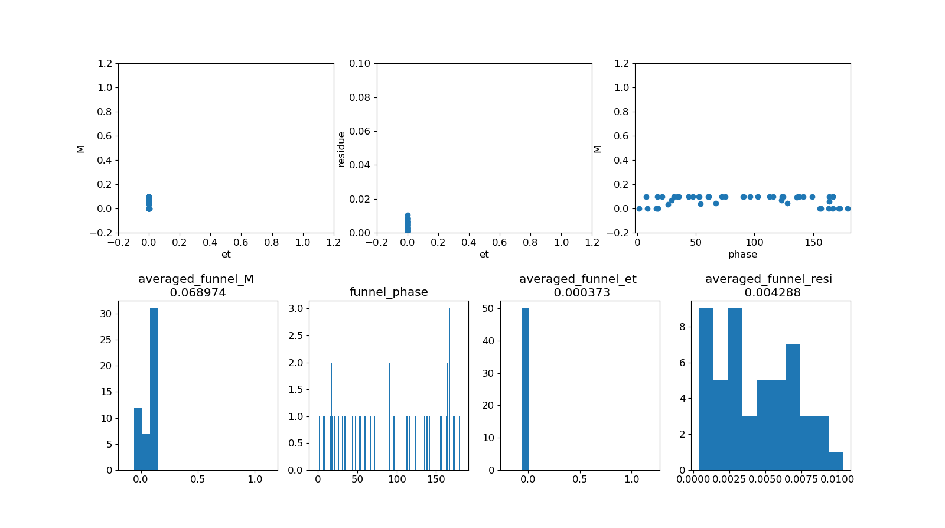
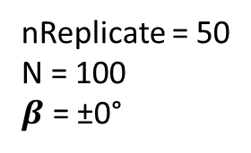
nReplicate = 50
N = 100
$β$ = ±0°

Slide 11
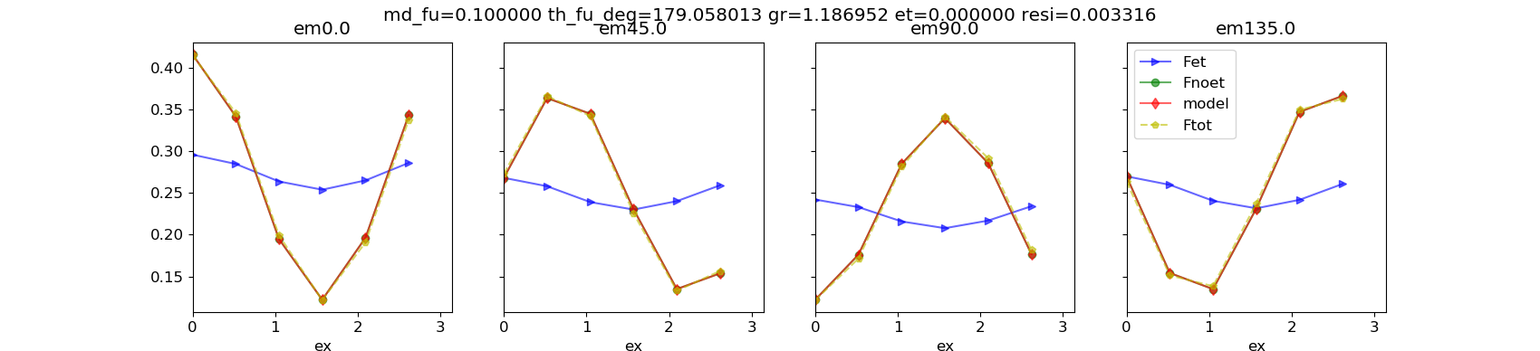
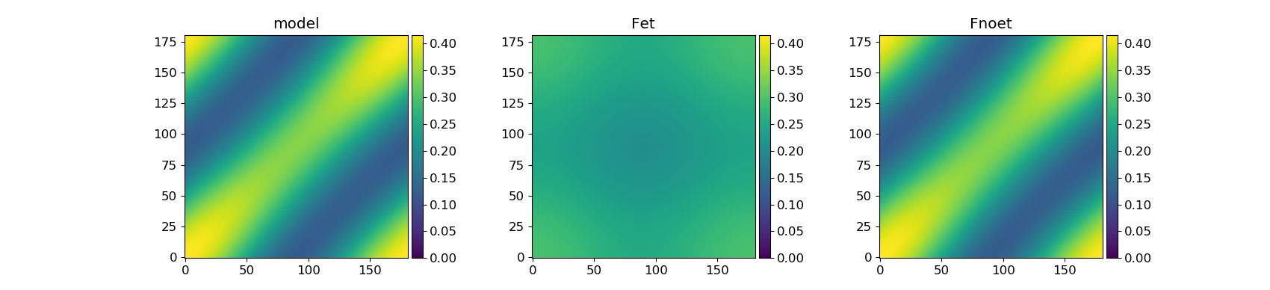
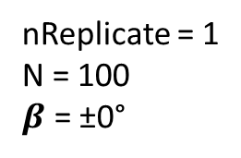
nReplicate = 1
N = 100
$β$ = ±0°

Slide 12
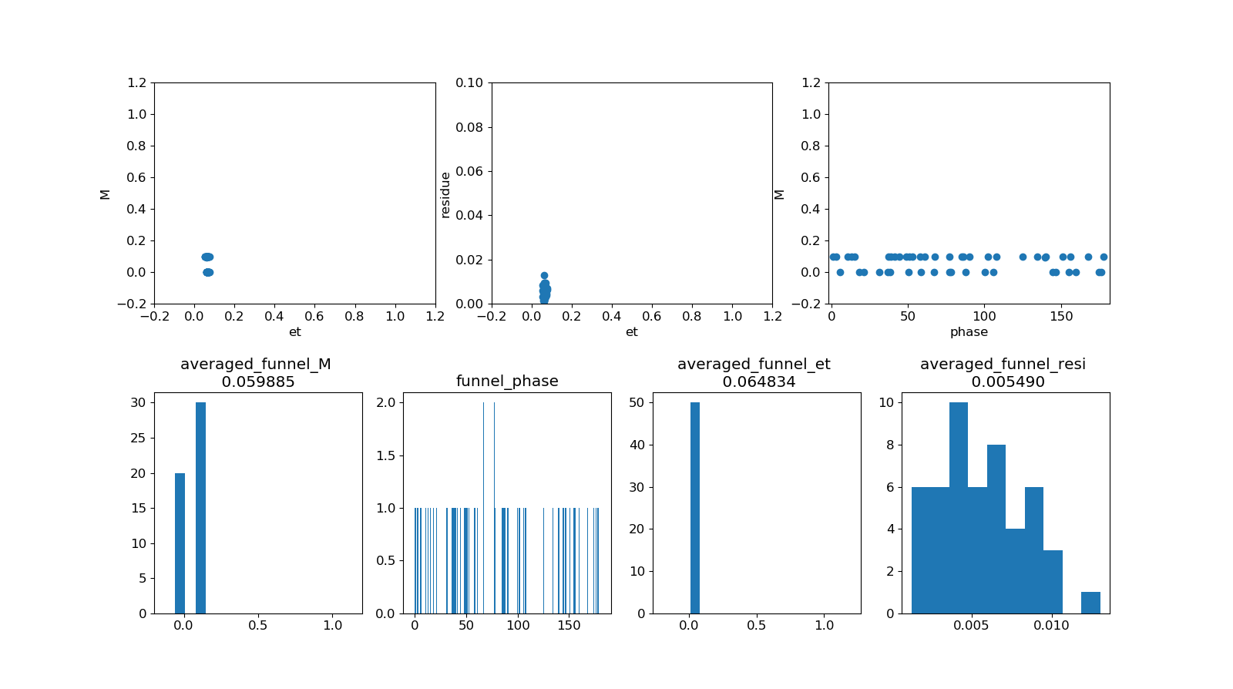
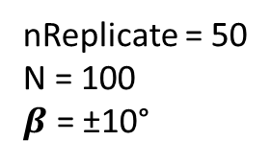
nReplicate = 50
N = 100
$β$ = ±10°

Slide 13
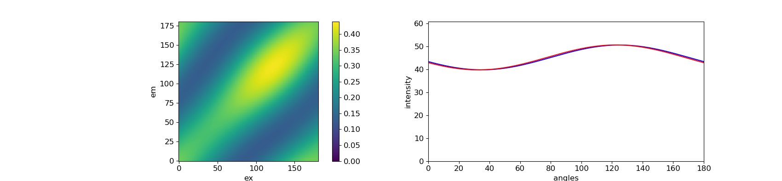
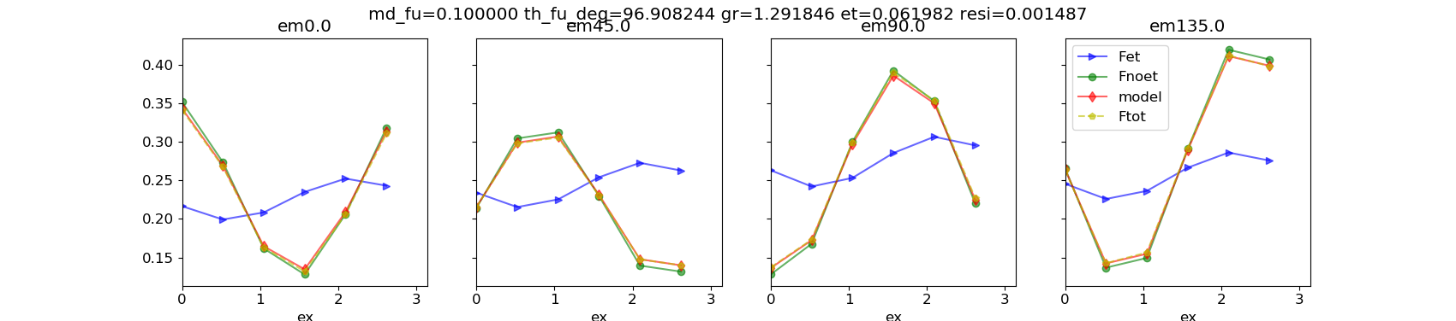
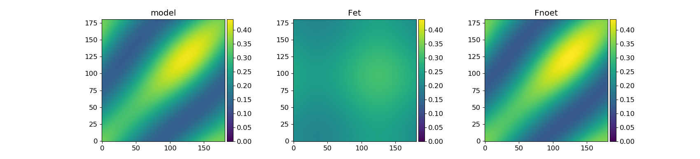
nReplicate = 50
N = 100
$β$ = ±10°

Slide 14
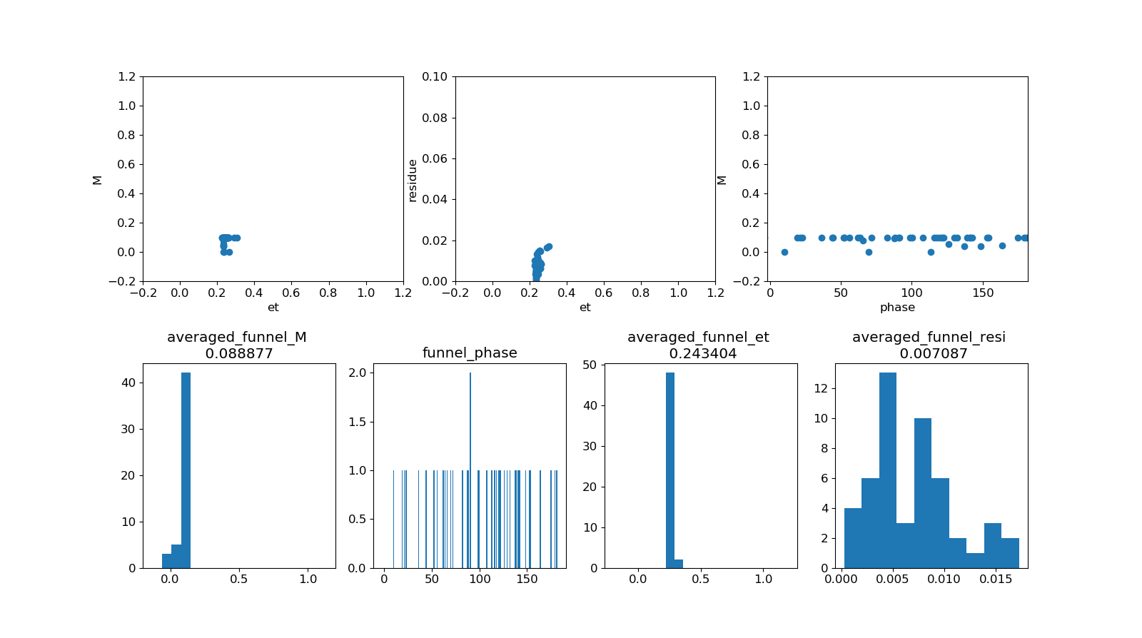
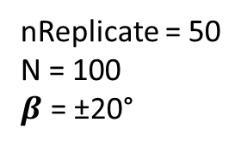
nReplicate = 50
N = 100
$β$ = ±20°

Slide 15
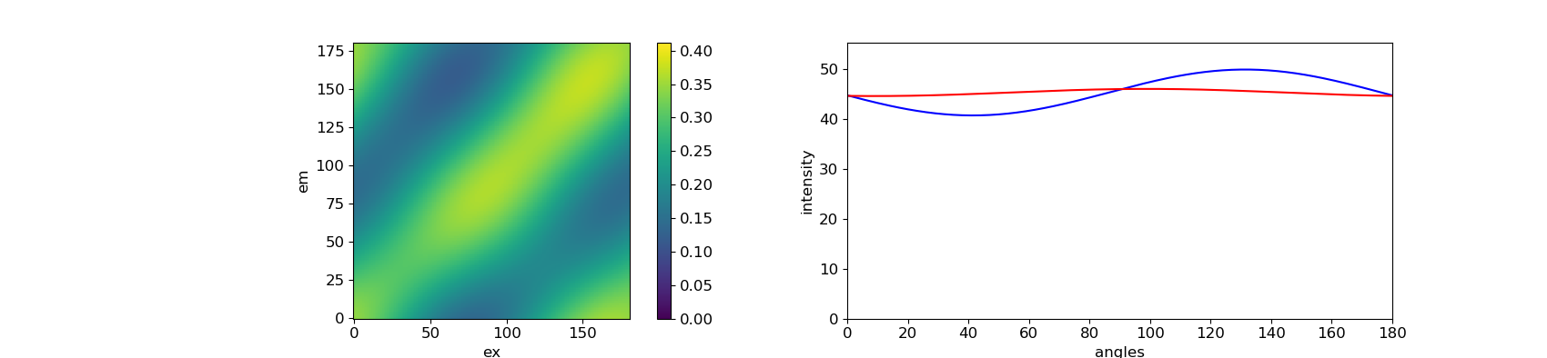
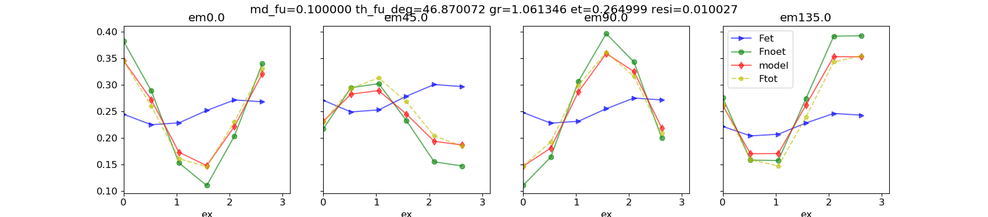
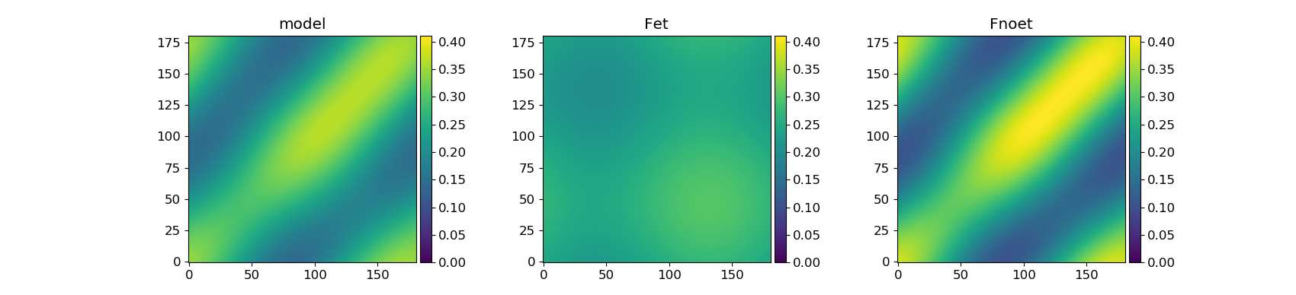
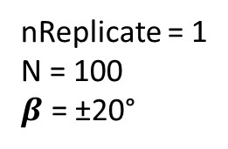
nReplicate = 1
N = 100
$β$ = ±20°

Slide 16
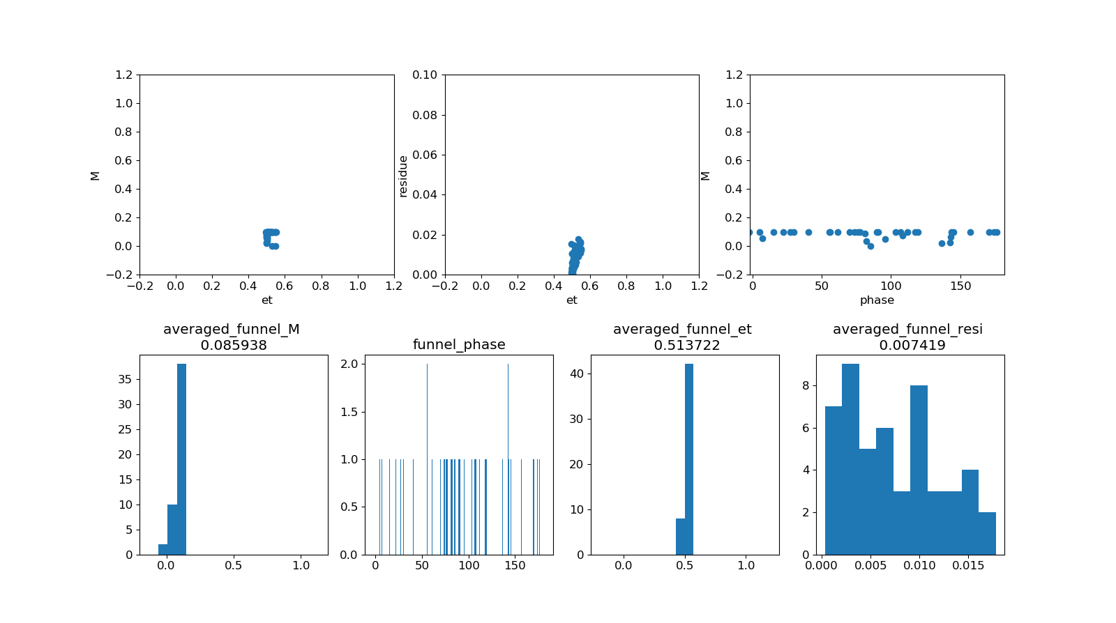
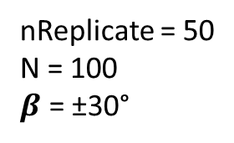
nReplicate = 50
N = 100
$β$ = ±30°

Slide 17
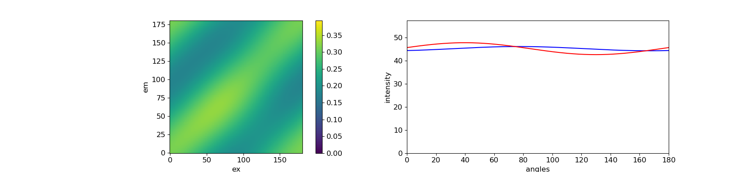
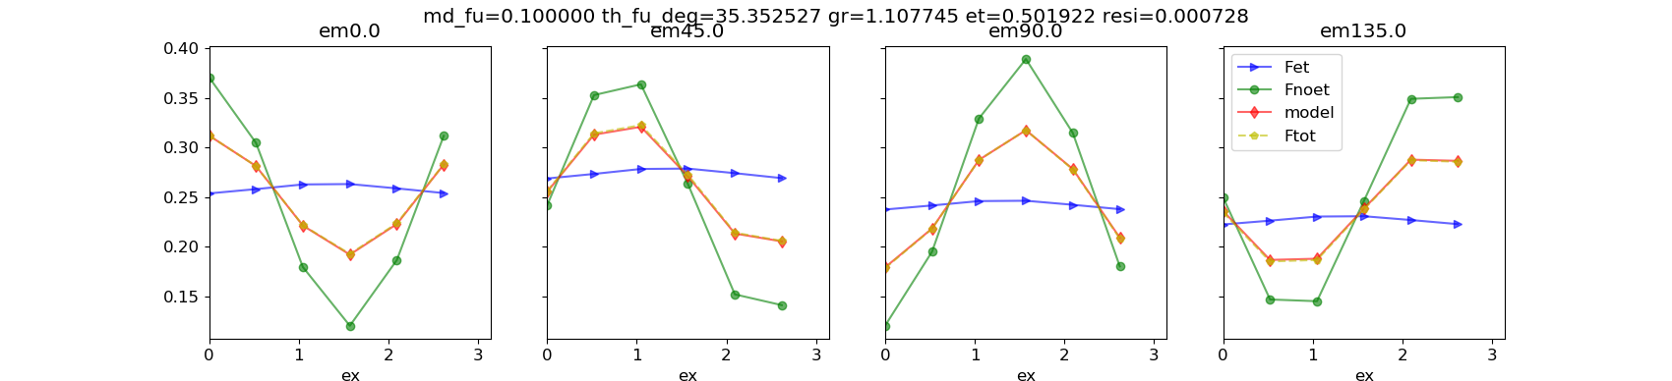
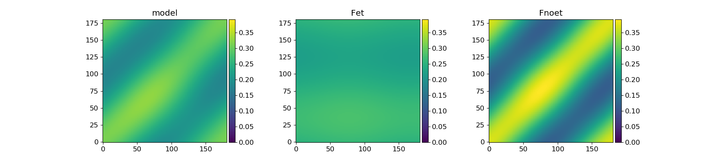

nReplicate = 1
N = 100
$β$ = ±30°

Slide 18


nReplicate = 50
N = 100
$β$ = ±40°

Slide 19



nReplicate = 1
N = 100
$β$ = ±40°

Slide 20


nReplicate = 50
N = 100
$β$ = ±50°
collection_of_functions.py:149: RuntimeWarning: invalid value encountered in arccos
alpha = 0.5 * np.arccos( .5*(((gr+2)*md_ex)-gr) )

Slide 21




nReplicate = 1
N = 100
$β$ = ±50°

Slide 22


nReplicate = 50
N = 100
$β$ = ±60°

Slide 23




nReplicate = 1
N = 100
$β$ = ±60°

Slide 24


nReplicate = 50
N = 100
$β$ = ±70°

Slide 25




nReplicate = 1
N = 100
$β$ = ±70°

Slide 26


nReplicate = 50
N = 100
$β$ = ±80°

Slide 27



nReplicate = 1
N = 100
$β$ = ±80°

Slide 28




$$r_{0}= \frac{2}{5} ×(\frac{3×\cos^{2}{β}−1}{2})$$
$$r_{0}=2×\frac{1−ε}{5+ε}$$

Slide 30




Three dipoles - Change the Mex from 0 to 1
100%
100%
$$β$$
Theta = [79, 109, 49]
The first one is the center dipole
bl = [False, True, True]
$β$ = 30°

Slide 31


100%
100%
$$β$$
100%
100%
$$β$$
100%
100%
$$β$$

Slide 32

Normalize
Calculate anisotropy

Slide 33


Slide 34


$β$ = 0°
Mex = 1

Slide 35


$β$ = 10°
Mex = 0.93

Slide 36


$β$ = 20°
Mex = 0.77

Slide 37


$β$ = 30°
Mex = 0.5

Slide 38


$β$ = 40°
Mex = 0.17

Slide 39


$β$ = 45°
Mex = 0.0

Slide 41



nReplicate = 50
N (number of molecules) = 100
100%
A molecule have independent polarized absorber (M = 1) and emitter (M = 1). 100% energy transfer from absorber to emitter.
$$β$$
Maybe I should fix the M_f close to 0 during the fitting ?
Check 2D portrait for different angles
Plot equation from reference
Only + angle
Only - angle

Slide 42

$$β$$ | +0° | +10° | +20° | +30° | +40° | +50° | +60° | +70° | +80°
M_f | 0.331 | 0.588 | 0.288 | 0.197 | 0.1255 | 0.1109 | 0.1164 | 0.1053 | 0.092
𝞮 | 0.0008 | 0.0613 | 0.2339 | 0.5000 | 0.8267 | 1.0000 | 1.0000 | 1.0000 | 1.000
resi | 0.0043 | 0.0248 | 0.0461 | 0.0619 | 0.0704 | 0.0717 | 0.0717 | 0.0720 | 0.072

Slide 43


nReplicate = 50
N = 100
$β$ = 0°

Slide 44



nReplicate = 1
N = 100
$β$ = 0°

Slide 45


nReplicate = 50
N = 100
$β$ = 10°

Slide 46




nReplicate = 1
N = 100
$β$ = 10°

Slide 47


nReplicate = 50
N = 100
$β$ = 20°

Slide 48



nReplicate = 50
N = 100
$β$ = 20°

Slide 49


nReplicate = 50
N = 100
$β$ = 30°

Slide 50




nReplicate = 1
N = 100
$β$ = 30°

Slide 51


nReplicate = 50
N = 100
$β$ = 40°

Slide 52




nReplicate = 1
N = 100
$β$ = 40°

Slide 53


nReplicate = 50
N = 100
$β$ = 50°

Slide 54




nReplicate = 1
N = 100
$β$ = 50°

Slide 55


nReplicate = 50
N = 100
$β$ = 60°

Slide 56




nReplicate = 1
N = 100
$β$ = 60°

Slide 57


nReplicate = 50
N = 100
$β$ = 70°

Slide 58




nReplicate = 1
N = 100
$β$ = 70°

Slide 59


nReplicate = 50
N = 100
$β$ = 80°

Slide 60



nReplicate = 1
N = 100
$β$ = 80°

Slide 62



SFA3 works for two dipole systems
90°
0°
0°, 90°
[1, 0
0, 1]
The emission is isotropic at 45 and 135 degree, which can also be seen from SFA3 fitting plot.
SFA3 plot (second row) can be seen as the cross section of the 2D portrait at em = 0, 45, 90, 135 degree.
SFA3 mathematically work in this case.
et = 0 means no energy transfer between two dipoles, also fit in the reality.
Feature of Fnoet:
Mnoet = 0, becasue Mex = 0
Fnoet should always be symmetric along diagnal.
Only two dipoles can be distinguished on 2D portrait.

Slide 63




For the system consisting of two dipoles without et ($et matrix=\left[\begin{matrix}1 & 0 \\ 0 & 1\end{matrix}\right]$), the model always work. Because the 2D portraits are alway symmetric along the diagnol, and this can always be fitted by Fnoet.
[0°, 30°]
[0°, 60°]
et = 0
noet = 1
The model fit mathematically and fit in the reality.
[0°, 90°]
[0°, 120°]

Slide 64






et_matrix =$\left[\begin{matrix}0 & 1 \\ 1 & 0\end{matrix}\right]$
[0°, 30°]
On the other word, if the 2D portrait are still axis symmetric along both diagonal and y axis after some kind of energy transfer (et is not equal not to 1), then the model can not work.
et portrait plays a role to break the symmetry (only in very special case et portrait is flat). Thus when there is et, the more asymmetry, the easier to be fit by the model. This explains the angle dependent results showing in the following figure.
[0°, 60°]
[0°, 90°]
[0°, 120°]

Slide 65
If the raw portrait are still symmetric along diagonal after energy transfer, then the model can not work.
model
et
noet
=
+
Asymmetry
Asymmetry
Only in few cases,
et can be flat
Symmetry

Slide 66




Mathematically the SFA3 model does not work, because the residue is high and 2D portraits are different.
However, the fitting results still give useful info. The fitting results show the property of the emitter (phase and M)
Also, et = 1 also agree with that there is strong energy transfer process within the system. But it is not single funnel.
[0°, 30°]
[0°, 60°]
100%
[0°, 72°]
30°
100%
30°
[0°, 120°]
M = 0.866
Phase = 15°
et = 1

Slide 67




Fill the hole
[0°, 90°, 0°, 90°]
[[0.0, 1.0, 0.0, 0.0],
[1.0, 0.0, 0.0, 0.0],
[0.0, 0.0, 1.0, 0.0],
[0.0, 0.0, 0.0, 1.0]]
100%
100%

Slide 68



[0°, 30°]
et_matrix =$\left[\begin{matrix}0 & 1 \\ 1 & 0\end{matrix}\right]$

Slide 69


[0°, 60°]
et_matrix =$\left[\begin{matrix}0 & 1 \\ 1 & 0\end{matrix}\right]$

Slide 70



[0°, 90°]
et_matrix =$\left[\begin{matrix}0 & 1 \\ 1 & 0\end{matrix}\right]$

Slide 71


[0°, 120°]
et_matrix =$\left[\begin{matrix}0 & 1 \\ 1 & 0\end{matrix}\right]$

Slide 73


[0°, 60°]
[0°, 60°]
$$et matrix=\left[\begin{matrix}0.0 & 1.0 \\ 0.0 & 1.0\end{matrix}\right]$$
$$et matrix=\left[\begin{matrix}0.0 & 1.0 \\ 1.0 & 0.0\end{matrix}\right]$$
100%
100%
100%
60°
60°
60°
One molecule have anisotropy absorption. After et, all the light emit from one polarized emitter (M = 1).
Two molecules possess different absorber (M = 1) and emitter (M = 1). Energy transfer happens within one molecule.

Slide 75
The SFA fitting results can give us some hint for an completely unknown system
M_funnel | phase_funnel | et
High | Different from the averaged excitation phase | The amount of energy are transferred | Energy flow to One or several specific emitters (funnel effect)
Low | Close to the averaged excitation phase | The amount of energy are transferred | There is some independent systems. And the energy transfer within each system.

Slide 76





[0°, 120°]
$$et matrix=\left[\begin{matrix}0.8 & 0.2 \\ 0.0 & 1.0\end{matrix}\right]$$
Phase_ex
One can judge if there is a single polarized emitter in the system from the phase and M of the funnel.
If the energy flow to only one dipole. No matter how much of the energy, SFA fitting always shows that M_funnel = 1, and phase of the funnel (the same as one of the emitter) is different from the average excitation phase.
The value of et shows how much energy transfer to this one emitter.

Slide 77




[0°, 30°, 60°, 90°]
[0.4, 0.6, 0.0, 0.0]
[0.0, 1.0, 0.0, 0.0]
[0.0, 0.6, 0.4, 0.0]
[0.0, 0.6, 0.0, 0.4]
M = 1
Phase of the funnel is different from the averaged excitation phase

Slide 78




0°, 30°, 60°, 90°
[1.0, 0.0, 0.0, 0.0]
[0.0, 1.0, 0.0, 0.0]
[0.2, 0.5, 0.3, 0.0]
[0.2, 0.5, 0.0, 0.3]
M = 1
Phase of the funnel is different from the averaged excitation phase

Slide 79





[0°, 120°]
$$et matrix=\left[\begin{matrix}0.8 & 0.2 \\ 0.2 & 0.8\end{matrix}\right]$$
M is relatively low
phase is very close to the average excitation phase.
It means that there is energy transfer process in the system (et shows how much it is), but the energy does not go to one specific emitter.
100%
120°
100%
120°

Slide 80




[0°, 30°, 60°, 90°]
[0.8, 0.2, 0.0, 0.0],
[0.4, 0.6, 0.0, 0.0],
[0.0, 0.0, 0.5, 0.5],
[0.0, 0.0, 0.2, 0.8]
M is low
Phase of the funnel is close to the averaged excitation phase

Slide 82

Multiple systems with different excitation polarization
Add more systems
0°
150°
P1
P2
et_1 = 1
et_2 = 1
ms = P1 + P2
The model does not work when both excitation and emission polarization are different.
That is why the following system does not work, because the excitation and emission polarization are different.
Set a criterion to judge if SFA work or not.

Slide 83

nReplicates = 50
N is the number of systems
In each system, there are two dipoles, and the angle between them is 30 degree.
100%
30°
$$et matrix=\left[\begin{matrix}0.0 & 1.0 \\ 0.0 & 1.0\end{matrix}\right]$$
A molecule have anisotropy absorption. After et, all the light emit from one polarized chromophore (M = 1).
N = 1
N = 2
N = 4

Slide 84


Slide 85



N = 1
N = 2
N = 4

Slide 86



N = 8
N = 16
N = 32

Slide 87



N = 64
N = 128
N = 256

Slide 88
Angle dependent?

Slide 90





[0°, 60°]
$$et matrix=\left[\begin{matrix}1.0 & 0.0 \\ 0.0 & 1.0\end{matrix}\right]$$

Slide 91





[0°, 60°]
$$et matrix=\left[\begin{matrix}0.8 & 0.2 \\ 0.2 & 0.8\end{matrix}\right]$$
et = 0.2 * 2
Even the ex and em polarization are the same, there still could be et in the system. And our model can extract the et coefficient as an indication.

Slide 92





[0°, 60°]
$$et matrix=\left[\begin{matrix}0.7 & 0.3 \\ 0.3 & 0.7\end{matrix}\right]$$
et = 0.3 * 2

Slide 93





[0°, 60°]
$$et matrix=\left[\begin{matrix}0.5 & 0.5 \\ 0.5 & 0.5\end{matrix}\right]$$
et = 0.5 * 2

Slide 94




[0°, 60°]
$$et matrix=\left[\begin{matrix}0.3 & 0.7 \\ 0.7 & 0.3\end{matrix}\right]$$

Slide 95




[0°, 60°]
$$et matrix=\left[\begin{matrix}0.2 & 0.8 \\ 0.8 & 0.2\end{matrix}\right]$$

Slide 96




[0°, 60°]
$$et matrix=\left[\begin{matrix}0.0 & 1.0 \\ 1.0 & 0.0\end{matrix}\right]$$

Slide 98

Generally SFA3 can work for two dipole system.
SFA3 does not work when energy transfer from 0 to 90, 30 to 120, or 45 to 135. (as long as the angles are 90 degrees different)
2D portrais is completely mismatch and the phase is always 90 degree off.
But SFAS works when energy transfer from 90 to 0, 135 to 45.
Does it mean something or just a bug in the system?
It is a bug in the system!!!
The key point is how to set the ininitial value of excitation phase when the Mex = 0
Correct the program
Collection_of_functions.py
Def compute_ex_em_modulation_phase
M_ex = (np.amax(I_ex) - np.amin(I_ex))/(np.amax(I_ex) + np.amin(I_ex))
if M_ex < 1e-6:
M_ex = 0.0
phase_ex = np.mean(theta) * np.pi / 180
else:
phase_ex = np.argmax(I_ex) * np.pi / 180

Slide 99




90°
80%
0°
0°, 90°
[0.2, 0.8
0.0, 1.0]
SFA3 mathematically does not work.
et = 0.8 makes sense, but the phase of funnel should not be at 0 degree.
And the more energy transfer from 0 to 90, the higher the residue will be.

Slide 100




120°
80%
30°
30°, 120°
[0.2, 0.8
0.0, 1.0]
SFA3 mathematically does not work.
et = 0.8 makes sense, but the phase of funnel should not be at 30 degree.

Slide 101




90°
80%
0°
0°, 90°
[1.0, 0.0
0.8, 0.2]
SFA3 mathematically works.

Slide 102




120°
80%
30°
30°, 120°
[1.0, 0.0
0.8, 0.2]
SFA3 mathematically works.

Slide 103
SI

Slide 104





[0°, 120°]
$$et matrix=\left[\begin{matrix}1.0 & 0.0 \\ 0.8 & 0.2\end{matrix}\right]$$

Slide 105
Mathematically fit or not
Reality fit or not

Slide 106

Multiple emitters in one system
emitter1
emitter1
emitter2
emitter2
emitter3
$$I= \overline{I}[M×\cos\left(2×\left[φ−θ\right]\right)+1]$$
$$I_{funnel}=I_{emitter1}+I_{emitter2}+…I_{emittern}$$
The funnel is the linear superposition of all individual emitters.
The SFA model works well for multiple emitters exist in one system.

Slide 107






Two emitters
0°
36°
et_matrix =$\left[\begin{aligned}0.4 ⋯ 0.6 ⋯ 0 ⋯ 0 \\ 0.4 ⋯ 0.6 ⋯ 0 ⋯ 0 \\ 0.4 ⋯ 0.6 ⋯ 0 ⋯ 0 \\ ⋮ \\ 0.4 ⋯ 0.6 ⋯ 0 ⋯ 0 \\ 0.4 ⋯ 0.6 ⋯ 0 ⋯ 0 \\ 0.4 ⋯ 0.6 ⋯ 0 ⋯ 0\end{aligned} \right]$
1000
$$I= \overline{I}[M×\cos\left(2×\left[φ−θ\right]\right)+1]$$
$$I_{funnel}=1×[0.82×\cos\left(2×\left[φ−22.14°\right]\right)+1]$$
$$I_{emitter1}=0.4×[1×\cos\left(2×\left[φ−0°\right]\right)+1]$$
$$I_{emitter2}=0.6×[1×\cos\left(2×\left[φ−36°\right]\right)+1]$$
1000
funnel
$\overline{I}$ (ε) = 0.999394
M = 0.82
$θ$ = 22.14 °
The funnel is the linear superposition of all individual emitters.
0°
36°
180 °
emitter1
$\overline{I}$ = 0.4
M = 1
$θ$ = 0 °
emitter2
$\overline{I}$ = 0.6
M = 1
$θ$ = 36 °

Slide 108



Two emitters
ET
36°, 60%
0°, 40%
1000 dipoles

Slide 109







Three emitters
0°
36°
72°
et_matrix =$\left[\begin{aligned} 0.4 ⋯ 0.3 ⋯ 0.3 ⋯ 0 ⋯ 0 \\ 0.4 ⋯ 0.3 ⋯ 0.3 ⋯ 0 ⋯ 0 \\ 0.4 ⋯ 0.3 ⋯ 0.3 ⋯ 0 ⋯ 0 \\ ⋮ \\ ⋮ \\ 0.4 ⋯ 0.3 ⋯ 0.3 ⋯ 0 ⋯ 0 \\ 0.4 ⋯ 0.3 ⋯ 0.3 ⋯ 0 ⋯ 0 \\ 0.4 ⋯ 0.3 ⋯ 0.3 ⋯ 0 ⋯ 0\end{aligned} \right]$
1000
$$I= \overline{I}[M×\cos\left(2×\left[φ−θ\right]\right)+1]$$
$$I_{funnel}=I_{emitter1}+I_{emitter2}+I_{emitter3}$$
1000
funnel
$\overline{I}$ (ε) = 0.9999
M = 0.52
$θ$ = 30.78°
0°
36°
72°
180 °
emitter1
$\overline{I}$ = 0.4
M = 1
$θ$ = 0 °
emitter2
$\overline{I}$ = 0.3
M = 1
$θ$ = 36 °
emitter3
$\overline{I}$ = 0.3
M = 1
$θ$ = 72 °

Slide 110



Three emitters
72°, 30%
ET
36°, 30%
0°, 40%
1000 dipoles

Slide 111

1000 emitters
et_matrix =$\left[\begin{aligned}0.001 ⋯0.001⋯0.001⋯0.001 \\ 0.001 ⋯0.001⋯0.001⋯0.001 \\ 0.001 ⋯0.001⋯0.001⋯0.001 \\ ⋮ ⋮ ⋮ ⋮ \\ ⋮ ⋮ ⋮ ⋮ \\ 0.001 ⋯0.001⋯0.001⋯0.001 \\ 0.001 ⋯0.001⋯0.001⋯0.001 \\ 0.001 ⋯0.001⋯0.001⋯0.001\end{aligned} \right]$
1000
1000
funnel
Intensity (ε) = 0.9999
M = 0.001
Phase = 11 °
0°
180 °
emitters
Intensity = 1/1000
M = 1
Phase = 0°- 180°

Slide 112



1000 emitters
ET
1000 dipoles
All dipoles, 0.1%

Slide 114
Multiple systems (ms)
0°
36°
P1
P2
et_1 = 1
et_2 = 1
0.4
0.6
ms = 0.4*P1 + 0.6*P2
If the ratio between two systems is the same as the ratio between two emitters in one system, then the 2D portrait and fitting results are the same.
From the above equation, if the excitation polarization of the two systems is the same, then the funnel will be a linear superposion of all systems. And the SFA can work properly.
Perhaps the key point is if the two system possess the same excitaion.

Slide 115



Slide 116

emitter1
emitter2

Slide 117
Multiple systems (ms)
72°
0°
36°
P1
P2
P3
et_1 = 1
et_2 = 1
et_3 = 1
0.4
0.3
0.3
ms = 0.4*P1 + 0.3*P2 + 0.3*P3

Slide 118



Slide 119
Multiple systems
0°
36°
P1
P2
P3
et_1 = 0
et_2 = 1
et_3 = 1
0.333
0.333
0.333
ms = 0.333*P1 + 0.333*P2 + 0.333*P3

Slide 120


no et
$$I= \overline{I}[M×\cos\left(2×\left[φ−θ\right]\right)+1]$$
$$I_{funnel}=0.667×\left[0.808×\cos\left(2×\left[φ−17.99°\right]\right)+1\right]+(1−0.667)$$
$$I_{emitter1}=0.333×[0×\cos\left(2×\left[φ−0°\right]\right)+1]$$
$$I_{emitter2}=0.333×[1×\cos\left(2×\left[φ−0°\right]\right)+1]$$
$$I_{emitter3}=0.333×[1×\cos\left(2×\left[φ−36°\right]\right)+1]$$

Slide 121




Slide 122
Multiple systems with different excitation polarization
0°
150°
More systems
P1
P2
et_1 = 1
et_2 = 1
ms = P1 + P2
The model does not work when both excitation and emission polarization are different.
That is why the following system does not work, because the excitation and emission polarization are different.
Set a criterion to judge if SFA work or not.

Slide 123



P1

Slide 124



P2

Slide 125



ms

Slide 126
Multiple systems with different excitation polarization, but the same emission.
0°
0°
P1
P2
et_1 = 1
et_2 = 1
ms = P1 + P2
The model works when excitation is different, but emission is the same (single funnel).
All is about if we can linealy sum equations (19)
The model works if one of the terms is the same for different systems.
term1
term2

Slide 127
P1

Slide 128



P2

Slide 129



ms

Slide 131














Isotropic solution
No et
Full et
$$ε=0$$
$$ε=0.2$$
$$ε=0.5$$
$$ε=1$$
$$p= \frac{1−ε}{2}$$
$$r=2×\frac{1−ε}{5+ε}$$

Slide 132



1000 dipoles
ET
1000 dipoles
All dipoles, 0.1%
et_matrix = $\left[\begin{matrix}0.001 & ⋯ & 0.001 \\ ⋮ & ⋱ & ⋮ \\ 0.001 & ⋯ & 0.001\end{matrix}\right]$

Slide 133
1000 emitters
et_matrix =$\left[\begin{aligned}0.001 ⋯0.001⋯0.001⋯0.001 \\ 0.001 ⋯0.001⋯0.001⋯0.001 \\ 0.001 ⋯0.001⋯0.001⋯0.001 \\ ⋮ ⋮ ⋮ ⋮ \\ ⋮ ⋮ ⋮ ⋮ \\ 0.001 ⋯0.001⋯0.001⋯0.001 \\ 0.001 ⋯0.001⋯0.001⋯0.001 \\ 0.001 ⋯0.001⋯0.001⋯0.001\end{aligned} \right]$
1000
1000
funnel
Intensity (ε) = 0.9999
M = 0.001
Phase = 11 °
0°
180 °
emitters
Intensity = 1/1000
M = 1
Phase = 0°- 180°

Slide 134


1000 dipoles
No ET
1000 dipoles
All dipoles, 0.1%

Slide 136


Some confusion about excitation! Think later.
If the absorber is isotropic, then noet portrait is
If the absorber is polarized, then noet portrait is
Why is the noet component only dependent on the Mex?
What is the meaning of M_noet?

Slide 137



Use small system to check the no et component.
[0°, 30°, 60°, 90°]

Slide 138


0°, 30°, 60°, 90°
[0 , 1 , 0 , 0
0 , 1 , 0 , 0
0 , 1 , 0 , 0
0 , 1 , 0 , 0]
Why et = 1?
Considering the reality, the energy of the second dipole stays.

Slide 139


Slide 140



0°, 30°, 60°, 90°
[0.6, 0.4, 0.0, 0.0]
[0.0, 1.0, 0.0, 0.0]
[0.0, 0.4, 0.6, 0.0]
[0.0, 0.4, 0.0, 0.6]

Slide 141



Slide 142
0°, 30°, 60°, 90°
[1.0, 0.0, 0.0, 0.0]
[0.0, 1.0, 0.0, 0.0]
[0.2, 0.5, 0.3, 0.0]
[0.2, 0.5, 0.0, 0.3]

Slide 144
The dipole orientation also influence the fitting results???
[0, 30, 60, 90], no et, fitting is perfect

Slide 145



[0, 36, 72, 90], no et, fitting is not so perfect

Slide 147
Calculate the similarity of two images

Slide 148
Energy transfer (et) simulation project
Motivation
1. Understand the meaning of single funnel in reality by manually setting up the dipole system and energy transfer matrix.
2. Find out in which case the SFA+3 model does not work properly. This will give us a clue that for which kind of experimental data, we can not trust the results from SFA model.
3. Based on the above results, try to come up with a more optimized model. Or maybe we need different models for different experimental systems.

Slide 149



Geranal information
The work can be seperated as three steps:
Step 1: Plot 2D portrait by manually setting steady ET matix and dipole orientations.
In the following example
Dipoles oriente at 0 and 60 degree, et_matrix = $\left(\begin{matrix}0.5 & 0.5 \\ 0 & 1\end{matrix}\right)$.
Blue curve – excitation. Red curve – emission.
0°
60°
90°
Dipole
orientation
Y
$$θ$$
0°
Z

Slide 150


Step 2: Fit the above system by SFA + 3 model
The data used for fitting is Ftotnormed extrated from the above 2D portrait. Ftotnormend is a 4 × 6 matrix (24 data points in total), and sum(Ftotnormed) = 1.
After SFA + 3 fitting, we get new 24 data points (model_norm) . sum(model_norm) = 1.
$$residue= \sqrt{{(Fotnormed −model_norm )}^{2}}$$
I plot the 24 data points in the following figure. One can compare the red points (raw data) and the yellow points (fit data). In this case, two curves are perfectly overlapped and it shows that the residue is close to 0.
model = et*Fet + (1-et)*Fnoet

Slide 151


Fitting result is not dependent on the number of input data.

Slide 152


Step 3: reconstruct 2D portraits of model, Fet, Fnoet
Dipoles oriente at 0 and 60 degree
et_matrix = $\left(\begin{matrix}0.5 & 0.5 \\ 0 & 1\end{matrix}\right)$
model = et * Fet + (1 - et) * Fnoet
Normalization:
sum(model) = sum (Fet) = sum (Fnoet) = 1

Slide 153

Case 1
What does it mean in the reality?
et_matrix = $\left(\begin{matrix}0 & 1 \\ 1 & 0\end{matrix}\right)$
SFA + 3 model does not work for that two dipoles exchange energy.
The larger the angle between the two dipoles (maximum at 90 degree), the higher the residues, as shown in the above figure.
There are details of the 2D portrait and fitting results in next slide.

Slide 154








Orientation of two dipoles
0, 0
0, 30
0, 60
0, 90

Slide 155

Case 2:
1000 dipoles random oriented and being excited.
The dimension of the steady state ET matrix is 1000*1000.
SFA+3 model works properly in the cases of one emitter $\left[\begin{matrix}1 & ⋯ & 0 \\ ⋮ & ⋱ & ⋮ \\ 1 & ⋯ & 0\end{matrix}\right]$, two emitters $\left[\begin{matrix}0.4⋯0.6 & ⋯ & 0 \\ ⋮ ⋮ & ⋱ & ⋮ \\ 0.4⋯0.6 & ⋯ & 0\end{matrix}\right]$, three emitters $\left[\begin{matrix}0.4⋯0.3⋯0.3 & ⋯ & 0 \\ ⋮ ⋮ ⋮ & ⋱ & ⋮ \\ 0.4⋯0.3⋯0.3 & ⋯ & 0\end{matrix}\right]$, no ET process $\left[\begin{matrix}1 & ⋯ & 0 \\ ⋮ & ⋱ & ⋮ \\ 0 & ⋯ & 1\end{matrix}\right]$
SFA+3 does not work properly for two cases:
et_matrix = $\left[\begin{matrix}0 & ⋯ & 1 \\ ⋮ & ⋱ & ⋮ \\ 1 & ⋯ & 0\end{matrix}\right]$
et_matrix = $\left[\begin{matrix}0.001 & ⋯ & 0.001 \\ ⋮ & ⋱ & ⋮ \\ 0.001 & ⋯ & 0.001\end{matrix}\right]$

Slide 156

One emitter
Schematic diagram of the emitter and single funnel.
$$Intensity of each emitter=({et}_{1,1}+{et}_{2,1}+{et}_{3,1}…+{et}_{180,1})/number_of_dipoles$$
0°
et_matrix = $\left[\begin{matrix}1 & ⋯ & 0 \\ ⋮ & ⋱ & ⋮ \\ 1 & ⋯ & 0\end{matrix}\right]$
funnel
Intensity (ε) = 1
M = 0.99999
Phase = 0°
0°
180 °
emitter
Intensity = 1
M = 1
Phase = 0°

Slide 157



One emitter
ET
0°, 100%
1000 dipoles

Slide 158


Two emitters
0°
36°
et_matrix =$\left[\begin{aligned}0.4 ⋯ 0.6 ⋯ 0 ⋯ 0 \\ 0.4 ⋯ 0.6 ⋯ 0 ⋯ 0 \\ 0.4 ⋯ 0.6 ⋯ 0 ⋯ 0 \\ ⋮ \\ 0.4 ⋯ 0.6 ⋯ 0 ⋯ 0 \\ 0.4 ⋯ 0.6 ⋯ 0 ⋯ 0 \\ 0.4 ⋯ 0.6 ⋯ 0 ⋯ 0\end{aligned} \right]$
1000
1000
$$I= \overline{I}[M×\cos\left(2×\left[φ−θ\right]\right)+1]$$
$$I_{funnel}=I_{emitter1}+I_{emitter2}$$
The funnel is the linear superposition of all individual emitters.
funnel
$\overline{I}$ (ε) = 0.999394
M = 0.82
$θ$ = 22.14 °
0°
36°
180 °
emitter1
$\overline{I}$ = 0.4
M = 1
$θ$ = 0 °
emitter2
$\overline{I}$ = 0.6
M = 1
$θ$ = 36 °

Slide 159


Two emitters
ET
36°, 60%
0°, 40%
1000 dipoles

Slide 160

Three emitters
0°
36°
72°
et_matrix =$\left[\begin{aligned} 0.4 ⋯ 0.3 ⋯ 0.3 ⋯ 0 ⋯ 0 \\ 0.4 ⋯ 0.3 ⋯ 0.3 ⋯ 0 ⋯ 0 \\ 0.4 ⋯ 0.3 ⋯ 0.3 ⋯ 0 ⋯ 0 \\ ⋮ \\ ⋮ \\ 0.4 ⋯ 0.3 ⋯ 0.3 ⋯ 0 ⋯ 0 \\ 0.4 ⋯ 0.3 ⋯ 0.3 ⋯ 0 ⋯ 0 \\ 0.4 ⋯ 0.3 ⋯ 0.3 ⋯ 0 ⋯ 0\end{aligned} \right]$
1000
$$I= \overline{I}[M×\cos\left(2×\left[φ−θ\right]\right)+1]$$
$$I_{funnel}=I_{emitter1}+I_{emitter2}+I_{emitter3}$$
1000
funnel
$\overline{I}$ (ε) = 0.9999
M = 0.52
$θ$ = 30.78°
0°
36°
72°
180 °
emitter1
$\overline{I}$ = 0.4
M = 1
$θ$ = 0 °
emitter2
$\overline{I}$ = 0.3
M = 1
$θ$ = 36 °
emitter3
$\overline{I}$ = 0.3
M = 1
$θ$ = 72 °

Slide 161


Three emitters
72°, 30%
ET
36°, 30%
0°, 40%
1000 dipoles

Slide 162

1000 emitters (no ET)
et_matrix =$\left[\begin{matrix}1 & ⋯ & 0 \\ ⋮ & ⋱ & ⋮ \\ 0 & ⋯ & 1\end{matrix}\right]$
SFA+3 works.
Result shows intensity is close to 0, which means there is no funnel.
funnel
Intensity (ε) = 0.00002
M = 0.001
Phase = 0 °
0°
180 °
emitters
Intensity = 1/1000
M = 1
Phase = 0°- 180°

Slide 163


No ET process
No ET
1000 dipoles

Slide 164

1000 emitters (solution)
SFA+3 Does not work
Although the residue is low, the original 2D portrait is different from the fitting 2D portrait.
et_matrix =$\left[\begin{matrix}0.001 & ⋯ & 0.001 \\ ⋮ & ⋱ & ⋮ \\ 0.001 & ⋯ & 0.001\end{matrix}\right]$
funnel
Intensity (ε) = 0.9999
M = 0.001
Phase = 11 °
0°
180 °
emitters
Intensity = 1/1000
M = 1
Phase = 0°- 180°

Slide 165


1000 emitters (solution)
ET
1000 dipoles
All dipoles, 0.1%

Slide 166

1000 emitters (energy are exchanged between two dipoles)
SFA+3 Does not work
The residue is high 0.05
et_matrix =$\left[\begin{matrix}0 & ⋯ & 1 \\ ⋮ & ⋱ & ⋮ \\ 1 & ⋯ & 0\end{matrix}\right]$
funnel
Intensity (ε) = 0.5
M = 0.001
Phase = 0 °
0°
180 °
emitters
Intensity = 1/1000
M = 1
Phase = 0°- 180°

Slide 167



1000 emitters (energy are exchanged between two dipoles)

Slide 169


180 dipoles random oriented and being excited.
The dimension of the steady state ET matrix is 180*180.
$$Intensity of emitter=({et}_{1,1}+{et}_{2,1}+{et}_{3,1}…+{et}_{180,1})/number_of_dipoles$$
1. One emitter
et_matrix = $\left[\begin{matrix}1 & ⋯ & 0 \\ ⋮ & ⋱ & ⋮ \\ 1 & ⋯ & 0\end{matrix}\right]$
0°
funnel
Intensity (ε) = 1
M = 1
Phase = 0
0°
180 °
emitter
Intensity = 1
M = 1
Phase = 0

Slide 170


2. two emitters
et_matrix = $\left[\begin{matrix}0.5⋯0.5 & ⋯ & 0 \\ \begin{aligned}⋮ ⋮ \\ ⋮ ⋮\end{aligned} & ⋱ & ⋮ \\ 0.5⋯0.5 & ⋯ & 0\end{matrix}\right]$
0°
30°
funnel
Intensity (ε) = 0.999983
M = 0.87
Phase = 15 °
0°
30°
180 °
emitter1
Intensity = 0.5
M = 1
Phase = 0 °
emitter2
Intensity = 0.5
M = 1
Phase = 30 °

Slide 171


3. two emitters
et_matrix = $\left[\begin{matrix}0.2⋯0.8 & ⋯ & 0 \\ \begin{aligned}⋮ ⋮ \\ ⋮ ⋮\end{aligned} & ⋱ & ⋮ \\ 0.2⋯0.8 & ⋯ & 0\end{matrix}\right]$
0°
30°
funnel
Intensity (ε) = 1.0000
M = 0.92
Phase = 24.4 °
0°
30°
180 °
emitter1
Intensity = 0.2
M = 1
Phase = 0 °
emitter2
Intensity = 0.8
M = 1
Phase = 30 °

Slide 172

4. three emitters
et_matrix =$\left[\begin{matrix}0.4⋯0.3⋯0.3 & ⋯ & 0 \\ ⋮ ⋮ ⋮ & ⋱ & ⋮ \\ 0.4⋯0.3⋯0.3 & ⋯ & 0\end{matrix}\right]$
0°
30°
60°
funnel
Intensity (ε) = 1.0000
M = 0.66
Phase = 26.3 °
0°
30°
60°
180 °
emitter1
Intensity = 0.4
M = 1
Phase = 0 °
emitter2
Intensity = 0.3
M = 1
Phase = 30 °
emitter3
Intensity = 0.3
M = 1
Phase = 60 °

Slide 173

5. 180 emitters, enery are exchanged between two dipoles.
et_matrix =$\left[\begin{matrix}0 & ⋯ & 1 \\ ⋮ & ⋱ & ⋮ \\ 1 & ⋯ & 0\end{matrix}\right]$
funnel
Intensity (ε) = 0.5
M = 0.001
Phase = 178.99 °
0°
180 °
emitters
Intensity = 1/180
M = 1
Phase = 0 °

Slide 174

1000 emitters – related to the isotropic solution
no ET process $\left[\begin{matrix}1 & ⋯ & 0 \\ ⋮ & ⋱ & ⋮ \\ 0 & ⋯ & 1\end{matrix}\right]$
funnel
Intensity (ε) = 0.00
M = 0.001
Phase = 0 °
0°
180 °
emitters
Intensity = 1/1000
M = 1
Phase = 0°- 180°

